Slide 1
Urban and Housing Issues in Canada
Dr. Dale Anderson
Notes:
Draft: April 28, 2014

Slide 2

Presentation Overview
Canada: Context
Government and Shared Responsibilities
Urbanism and Key Urban Issues
General Housing Concepts
Housing in British Columbia
Housing Policy in B.C.
Notes:
Overview of presentation
Canada: Context
Government and Shared Responsibilities
Urbanism and Key Urban Issues
General Housing Concepts
Housing in British Columbia
Housing Policy in B.C.

Slide 3
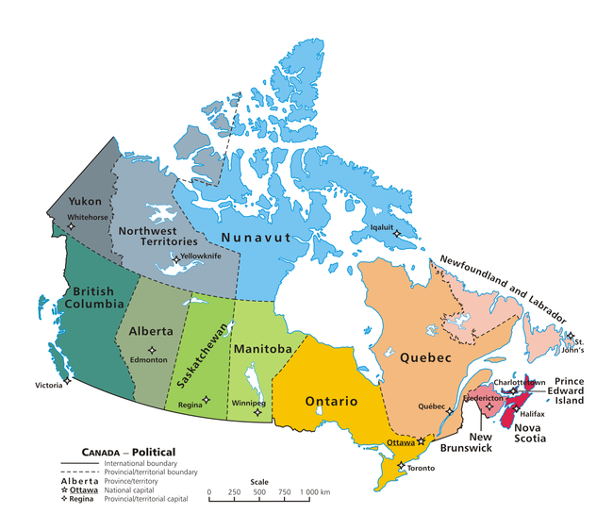
Notes:
Starting with an overview of Canada
Canada is the northern portion of North American (the continent)
Almost 10,000 square kilometres so a very large geographic area but very little population – about 35 million

Slide 4
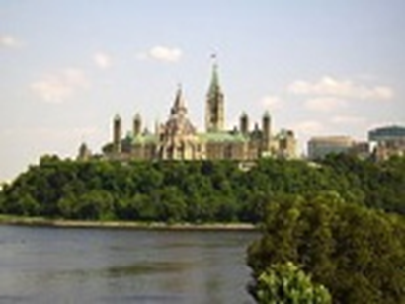
Context:
History
Late 15th century, British and French colonies on Atlantic coast
Eventually, United Kingdom gained territories
British North American Act of 1867 – three colonies formed Dominion of Canada
More colonies added to the self-governing dominion
1931 Britain granted Canada full independence
1982 – last ties dissolved
Aboriginal peoples were living in these colonies when Canada formed – still present today
Notes:
History – briefly
Late 15th century, British and French colonies on Atlantic coast
Eventually, United Kingdom gained territories
British North American Act of 1867 – three colonies formed Dominion of Canada
More colonies added to the self-governing dominion
1931 Britain granted Canada full independence
1982 – last ties dissolved
Aboriginal peoples were living in these colonies when Canada formed – still present today

Slide 5
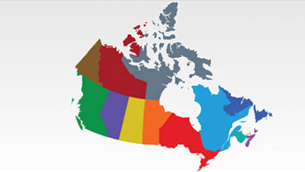
Canada today
10 provinces
3 territories
10 million square km (second largest country by area)
35 million people
Border shared with United States (and France)
Vast majority of population live within 200 km of USA
Highly multicultural, especially major metropolitan areas
Notes:
Canada Today - snapshot
10 provinces = southern, more powers and more people
3 territories = all in the north, represent large area but only about 100,000 people
P&Ts are divisions within the country – much like states in the United States – have powers such that there are some differences among them in day to day living
10 million square km (second largest country by area)
35 million people
Large, sparsely populated country
Border shared with United States (and France)
Vast majority of population live within 200 km of USA
Linear – most people live relatively close to the southern border with the United States
Highly multicultural, especially major metropolitan areas
Large population of British Ancestry and Western and Eastern European Ancestry = traditional immigrants
Newer Immigrants = all parts of Asia (esp. China, Hong Kong, India, Philippines)

Slide 6

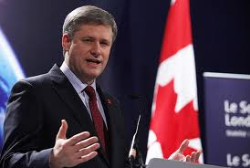
Government
Democratic constitutional monarchy
Head of State: Queen Elizabeth II
Head of Government: Elected Prime Minister
Federal government three branches
  Executive
  Legislative
  Judicial
Federal, and provincial /territorial governments share responsibilities
Queen has representatives in Canada
Notes:
Government
Democratic constitutional monarchy
Head of State: Queen Elizabeth II
Head of Government: Elected Prime Minister
Federal government three branches
Executive
Legislative
Judicial
Federal, and provincial /territorial governments share responsibilities
Queen has representatives in Canada
Approve legislation but primarily ceremonial role

Slide 7
Shared responsibilities
Federal Government
Areas of Responsibility
Areas of law listed in the Constitution Act, 1867
Generally affect the whole country
Sources of Revenue: Income tax, sales tax, corporate tax
National defence
Foreign affairs
Employment insurance
Banking
Federal taxes
Post office
Fisheries
Shipping, railways, telephones and pipelines
Aboriginal lands and rights
criminal law
Notes:
Shared Responsiblities
Responsibilities are shared by three levels of government
Federal + provincial + municipal government
Federal government = for the whole country
Areas of law listed in the Constitution Act, 1867
Generally affect the whole country
Sources of Revenue: Income tax, sales tax, corporate tax
Areas of Responsibility – examples
National defence
Foreign affairs
Employment insurance
Banking
Federal taxes
Post office
Fisheries
Shipping, railways, telephones and pipelines
Aboriginal lands and rights
criminal law

Slide 8
Shared responsibilities
Provincial Government
Areas of Responsibility
Areas of law listed in the Constitution Act, 1867
Generally affect individual provinces
Sources of Revenue: Income tax, sales tax, corporate taxes
Education
Health care
Some natural resources
Road regulations
Hospitals
Federal Prisons
Marriage
Property and civil rights
Agriculture and immigration shared with federal
Notes:
Provincial
Areas of law listed in the Constitution Act, 1867
Generally affect
Sources of Revenue: Income tax, sales tax, corporate taxes
Examples
Education
Health care
Some natural resources
Road regulations
Hospitals
Federal Prisons
Marriage
Property and civil rights
Agriculture and immigration shared with federal

Slide 9
Shared responsibilities
Municipal Government
Areas of Responsibility
“Creatures of the provinces”
Powers as granted by province
Property taxes
Emergency Services (police, fire, ambulance)
Local roads and infrastructure
Water, sewer
Community centres, libraries, swimming pools = typically
Notes:
Municipal or Local Government
Some provinces have two levels of local government
Municipal government and regional government
Differs by province
Regional government typically has responsibilities for items regional in nature – e.g., transit, sewage, regional growth planning and so forth
“Creatures of the provinces”
Powers as granted by province
Property taxes
Areas of responsibility
Emergency Services (police, fire, ambulance)
Local roads and infrastructure
Water, sewer
Community centres, libraries, swimming pools = typically

Slide 10
Shared responsibilities
First Nations
Areas of Responsibility
Changing status
Band councils
Sources of Revenue: varies – primarily federal government
Changing
On reserve = federal responsibility
Off reserve = provincial responsibility
Notes:
Other ‘governments’
First Nations (i.e., the original people in Canada before Europeans)
Changing status
Band councils
Sources of Revenue: varies – primarily federal government
Areas of responsibility
Changing
On reserve = federal responsibility and band council
Off reserve = provincial responsibility

Slide 11
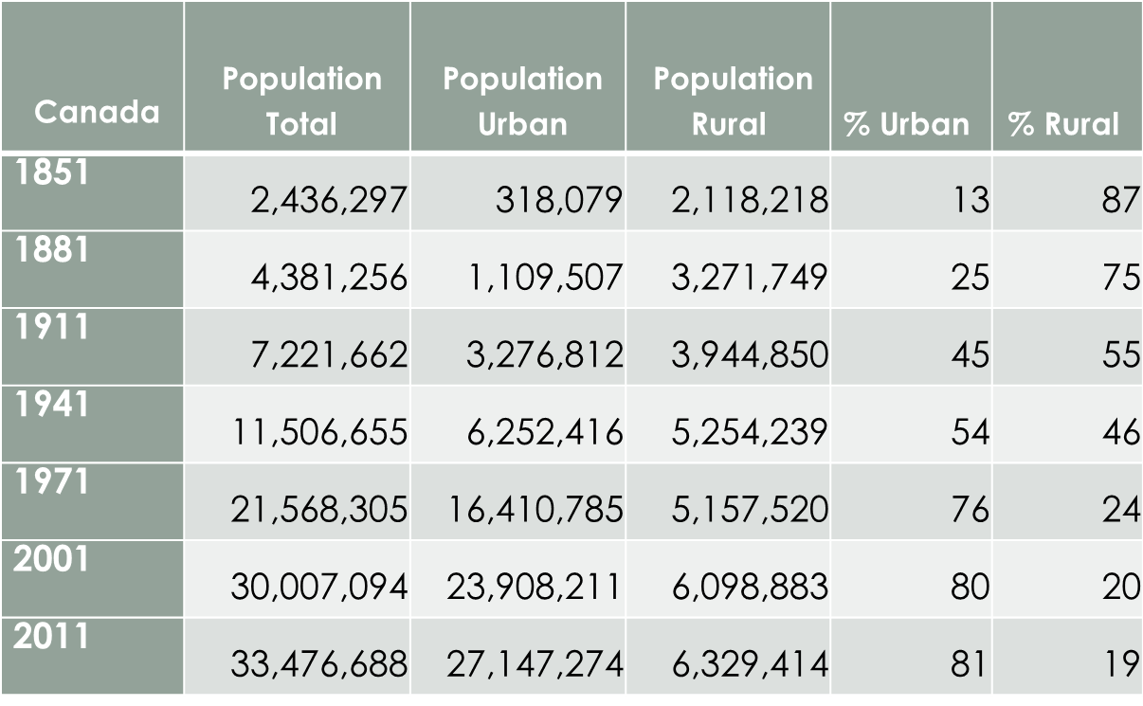
Urbanism – Over time
Notes:
Urbanism over time
Like many countries, Canada has become increasingly urban over time
When Canada was formed, the vast majority of the population was rural. – Almost 90%
Today, about 80% of the population is urban and 20% rural and it is continuing to decline
Population is increasing only due to immigration = without immigrants, Canada’s population would be declining
Most immigrants settle in one of Canada’s major centres – e.g., Toronto, Vancouver, Montreal

Slide 12
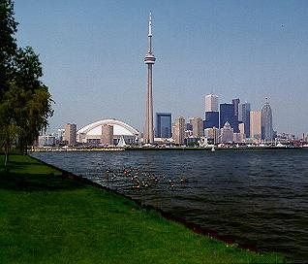
Urbanism Today
About 80% urban
10 million in three metropolitan areas:
  Toronto - 5M
  Montreal - 3.5M
  Vancouver - 2M
Notes:
Urbanism Today
As mentioned, Canada’s pop growing only due to immigration
Most immigrants settle in major urban centres – very few go to rural areas
Lots of multiculturalism in Canada = about 20% of population foreign born
In the City of Toronto, majority of pop is now ‘visible minority’ = meaning, majority of pop is ‘not white European or British background’
City of Vancouver = about 33% visible minority or so
http://www12.statcan.gc.ca/nhs-enm/2011/as-sa/99-010-x/99-010-x2011001-eng.cfm
Highlights
Immigration
In 2011, Canada had a foreign-born population^{Note 1} of about 6,775,800 people. They represented 20.6% of the total population, the highest proportion among the G8 countries.
Between 2006 and 2011, around 1,162,900 foreign-born people immigrated to Canada. These recent immigrants made up 17.2% of the foreign-born population and 3.5% of the total population in Canada.
Asia (including the Middle East) was Canada's largest source of immigrants during the past five years, although the share of immigration from Africa, Caribbean, Central and South America increased slightly.
The vast majority of the foreign-born population lived in four provinces: Ontario, British Columbia, Quebec and Alberta, and most lived in the nation's largest urban centres.
Ethnic ancestry
More than 200 ethnic origins were reported in the 2011 National Household Survey (NHS). In 2011, 13 different ethnic origins had surpassed the 1-million mark.
Visible minority population
Nearly 6,264,800 people identified themselves as a member of a visible minority group. They represented 19.1% of the total population. Of these visible minorities, 30.9% were born in Canada and 65.1% were born outside the country and came to live in Canada as immigrants. A small proportion (4.0%) of the visible minority population was non-permanent residents.
Combined, the three largest visible minority groups-South Asians, Chinese and Blacks-accounted for 61.3% of the visible minority population in 2011. They were followed by Filipinos, Latin Americans, Arabs, Southeast Asians, West Asians, Koreans and Japanese.
As was the case with the immigrant population, the vast majority lived in Ontario, British Columbia, Quebec and Alberta. Seven out of 10 lived in the three largest census metropolitan areas: Toronto, Montréal and Vancouver.
The visible minority population had a median age of 33.4 in 2011, compared with 40.1 for the population as a whole.^{Note 2}
Languages
Of the immigrants who had a single mother tongue, close to one-quarter (23.8%) reported English as their mother tongue and 3.4% reported French. Among those whose mother tongue was other than Canada's two official languages, Chinese languages were most common, followed by Tagalog, a language of the Philippines, Spanish and Punjabi.
Three-quarters (74.5%) of the foreign-born population were able to conduct a conversation in more than one language. In many cases, immigrants who could speak more than one language reported knowledge of English or French, in tandem with a non-official language: 61.2% were able to converse in English or French and one or more non-official language(s), 9.9% in English and French and one or more non-official language(s). Another 2.6% could speak English and French but not a non-official language. As well, 0.8% said they knew only non-official languages.
Religions in Canada
Just over 22.1 million people, two-thirds of Canada's population, reported they were affiliated with a Christian religion. Roman Catholics (roughly 12,728,900) were by far the largest Christian group, with adherents to the United Church the second largest group (about 2,007,600).
Slightly over 1 million individuals identified themselves as Muslim, representing 3.2% of the nation's total population. Hindus represented 1.5%, Sikhs 1.4%, Buddhists 1.1% and Jewish 1.0%.
More than 7.8 million people, nearly one-quarter of the population (23.9%), had no religious affiliation.

Slide 13
Other Major Urban centres
Rank | Metro Area | Pop 2011
1 | Toronto, Ontario | 5,583,064
2 | Montreal, Quebec | 3,824,221
3 | Vancouver, British Columbia | 2,313,328
4 | Ottawa-Gatineau, Ontario and Quebec | 1,236,324
5 | Calgary, Alberta | 1,214,839
6 | Edmonton, Alberta | 1,159,869
7 | Quebec City, Quebec | 765,706
8 | Winnipeg, Manitoba | 730,018
9 | Hamilton/Burlington, Ontario | 721,053
10 | Kitchener, Cambridge, Waterloo, Ontario | 477,160
11 | London, Ontario | 474,786
12 | Saint Catherine’s Niagara, Ontario | 392,184
13 | Halifax, Nova Scotia | 390,328
14 | Oshawa , Ontario | 356,177
15 | Victoria, British Columbia | 344,615
 | TOTAL | 19,983,672
Notes:
Major urban centres
15 of Canada’s largest urban areas represent over half the country’s population
Most are close to the American border, as noted earlier, except Edmonton and Calgary in Alberta
Note that in whole country, only 7 areas larger than 1 million people – no truly large urban areas

Slide 14
Urban Issues
Major Issues
Paradox
Urban sprawl
Municipal infrastructure: maintaining, renewing and costs of doing so
Housing: lack, affordability
Public transit and transportation
Climate change
Environmental quality
Immigration
Very high per capita income
High ranking on Human Development Index
High results for education, government transparency, civil liberties, quality of life, economic freedom
Notes:
Urban Issues
There are many issues facing Canada’s urban areas
Some of the main issues:
Urban sprawl = very inefficient development patterns especially since the Second World War
Municipal infrastructure: maintaining, renewing and costs of doing so = in part this is due to sprawl and in part a recent tendency by municipal governments not to raise property taxes
Housing: lack, affordability = especially since about 2003-4
Public transit and transportation = insufficient, much needs renewal (e.g., Vancouver Line in Vancouver – reached ‘target capacity’ in 5 years??)
Climate change = adaptation and mitigation strategies – flooding, changes in weather patterns, soil erosion, etc.
Environmental quality = disturbance in ecosystems and loss of wildlife habitat and thus wildlife = as a result of urban growth and other environmental degradation elsewhere – water quality, sewage disposal, landfills and what to do with garbage and how to increase % recycled materials
Immigration = stress on major urban centres and this is where most immigrants go; family reunification so immigrants not always highly skilled or able to speak English, many immigrants very poor and struggle financially
PARADOX
Canada is a ‘developed’ country but still has many problems

Slide 15
Housing in Canada
Features
Issues
Market: ownership or rental
Social housing – rental
High homeownership rates historically (67-70%)
Homeownership increasing over past decades*
Major changes by federal government after WWII
Affordability
Rental: Lack of new, quality of stock
Past development patterns and reliance on cars
Homeownership vs rental patterns changing
Energy and water efficiency and sustainability – compact communities
Notes:
Housing in Canada
Moving now to housing specifically
Want to introduce the ‘how housing works’ in Canada
Generally speaking, housing is one of two types:
Market: ownership or rental = no help to pay for this type of housing, the ‘market’ builds and sells or rents to people
Housing usually owned or rented
Social housing – type of rental housing that is mostly or all paid by government; purpose = to help those in financial need who can’t afford to pay for housing themselves
High homeownership rates historically (67-70%)
Homeownership increasing over past decades* = but in last decade, this is changing in larger urban centres and rates are lowering again..
Major changes by federal government after WWII = ‘created’ the housing system we have today – financial lenders, mortgages, builders, insurance companies etc. Before this, banks were major lenders and often required large downpayments (e.g., 50-60%) before they would lend money for a mortgage for a house
A lot of issues with housing in Canada
Affordability = housing across Canada becoming highly unaffordable for increasing numbers of people
British Columbia, province where I live, is the most unaffordable province in Canada
In part due to very high housing costs and in part to lower incomes than in some other parts of Canada
Rental: Lack of new rental housing, quality of existing rental stock can be poor/old
Past development patterns and reliance on cars
Homeownership vs rental patterns changing = especially in larger centres – e.g., Vancouver about 52% renters; Victoria about 60% renters
Energy and water efficiency and sustainability – compact communities = great resistance to change in Canadian cities. For so many years, everything was cheap and Canada is seen as having ‘lots of space’ and ‘lots of water’ and ‘lots of energy’ so why is there a need to change?
Building Code – changes in British Columbia – resistance to making more ‘energy efficient ‘

Slide 16
Shared Responsibility: Federal
Partnering in social housing
Funding – e.g., early stages of affordable housing project
Financial assistance such as First-time Home Buyers Tax Credit or Home Buyers Plan (use funds from retirement savings)
Providing mortgage insurance (<20% down payment)
Research on the housing market via Canada Mortgage and Housing Corporation
Exemptions from capital gains tax for principal residence
Affordability Examples
Notes:
Federal examples – shared responsib for affordability
So, addressing the housing affordability challenge is something that all levels of government are working on
SOME of the ways the federal government assists housing and housing affordability:
Partnering in social housing
Funding – e.g., early stages of affordable housing project
Financial assistance such as First-time Home Buyers Tax Credit or Home Buyers Plan (use funds from retirement savings)
Providing mortgage insurance (<20% downpayment)
Research on the housing market via Canada Mortgage and Housing Corporation
Exemptions from capital gains tax for principal residence

Slide 17
Shared Responsibility: Province
Regulation of real estate development and marketing
Home warranty insurance
Landlord-tenant relations
Overseeing land use planning and development finance
Funding public transit
Funding social housing programs and projects
Providing targeted rent supplements
Homeowner support – e.g., property-tax support, property tax deferment programs, first-time home buyers grant
Home adaptations for independence
Seniors Home Renovation Tax Credit
Building code for B.C. – example: options for secondary suites
Developing uniform technical standards that simplify building code compliance
Affordability Examples
Notes:
Some of the ways the provincial government assists housing and housing affordability:
Regulation of real estate development and marketing
Home warranty insurance (for new homes)
Landlord-tenant relations = are regulated,
Overseeing land use planning and development finance
Funding public transit
Funding social housing programs and projects
Providing targeted rent supplements
Homeowner support – e.g., property-tax support, property tax deferment programs, first-time home buyers grant
Home adaptations for independence
Seniors Home Renovation Tax Credit
Building code for B.C. – example: options for secondary suites
Developing uniform technical standards that simplify building code compliance

Slide 18
Shared Responsibility: Municipal
Regional growth strategies and community and neighbourhood plans – support affordable housing
Housing friendly regulatory environment (e.g., allowing secondary suites, density, good transit corridors, etc.)
Prezoning land
Property tax incentives for affordable housing
Streamlining development approval processes
Reducing permitting fees and development cost charges
Affordability Examples
Notes:
Some of the ways local governments support housing and housing affordability:
Regional growth strategies and community and neighbourhood plans – support affordable housing
Housing friendly regulatory environment (e.g., allowing secondary suites, density, good transit corridors, etc.)
Prezoning land
Property tax incentives for affordable housing
Streamlining development approval processes
Reducing permitting fees and development cost charges

Slide 19
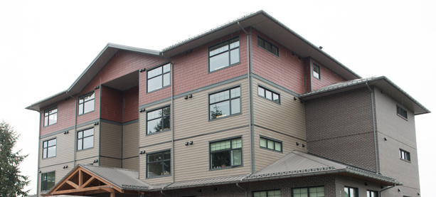
Housing concepts
Core Housing Need
  Adequate (repairs)
  Suitable (size)
  Affordable (<30% income)
Notes:
Housing Concepts – core housing need
http://cmhc.beyond2020.com/HiCODefinitions_EN.html#_Core_Housing_Need_Status
Core Housing Need Status
A household is said to be in core housing need if its housing falls below at least one of the adequacy, affordability or suitability, standards and it would have to spend 30% or more of its total before-tax income to pay the median rent of alternative local housing that is acceptable (meets all three housing standards).
Adequate housing are reported by their residents as not requiring any major repairs.
Affordable dwellings costs less than 30% of total before-tax household income.
Suitable housing has enough bedrooms for the size and make-up of resident households, according to National Occupancy Standard (NOS) requirements.
A household is not in core housing need if its housing meets all of the adequacy, suitability and affordability standards
OR,
If its housing does not meet one or more of these standards, but it has sufficient income to obtain alternative local housing that is acceptable (meets all three standards).
NOTE: Regardless of their circumstances, non-family households led by maintainers 15 to 29 years of age attending school full-time are considered to be in a transitional stage of life and therefore not in core housing need.

Slide 20
Housing in b.c.
Key Features
Issues
  Private market provides most housing (95%)
  Social/subsidized housing (5%)
  Ownership and rental
  Single detached housing predominates
Affordability becoming increasing concern
Homelessness
Large urban/industrial centres
Supply, affordability, quality
Sustainability features of building code
Notes:
Housing in BC
Key Features
Private market provides most housing (95%)
Social/subsidized housing (5%)
Ownership and rental
Single detached housing predominates
Issues = very similar to issues across the country
Affordability becoming increasing concern
Homelessness
Large urban/industrial centres
Supply, affordability, quality
Sustainability features of building code

Slide 21
Housing affordability in BC
City of Vancouver
City of Victoria
Single detached home ~ $1 million CDN
Average household income ~ $57,000
Renters: ~ 52%
Single detached home ~ $750,000 CDN
Average household income ~ $38,000
Renters ~60%
Notes:
Housing Affordability in BC
Indicated earlier that affordability of housing is a major issue
Would like to provide an example of the affordability challenge in British Columbia, my province
Average house prices are about 20 times average household incomes as you can see
A generation or two ago, average prices were 3-4 times average household incomes
I would say affordability is the greatest challenge today in housing in BC

Slide 22
Housing policy in b.c.
Housing Matters B.C.
Rent Control
Provincial housing policy document
Latest update 2014
Main policy document
Implementation: BC Housing and partners
Philosophy of partnerships
housingmattersbc.ca
Rent control features:
  Increase of inflation + 2%
  Deregulation between tenancies
  Above-guideline increases possible
Manufactured home parks – slight differences
Notes:
Housing Policy in BC
Housing Matters BC
Provincial housing policy document
Latest update 2014
Main policy document
Implementation: BC Housing and partners
Philosophy of partnerships
housingmattersbc.ca
Rent Control
Not all provinces have rent control – BC is one of about 4 that do
Rent control designed to balance needs of tenants and landlords and protect both
Rent control features:
Increase of inflation + 2%
Deregulation between tenancies
Above-guideline increases possible for unforeseen major repairs that arise
Manufactured home parks – slight differences
If needed, explain what these are and the differences

Slide 23
Housing Continuum/
Housing Spectrum
TEMPORARY ← --------------------------------- → PERMANENT
Emergency Shelters | Transitional Housing | Supported Housing | Assisted Living | Non-market Rental (Social Housing) | Rental Assistance in Private Market | Market Rental (Purpose Built) | Secondary Rental (Condos, Suites) | Ownership – Strata | Ownership – Non-Strata
← ----------------------- RENTAL ----------------------- → |  |  |  |  |  |  |  | ←OWNED→
MORE ← GOVERNMENT SUPPORT → LESS
Notes:
Explain the housing spectrum = what it is and that the housing policy document is meant to address the whole range of housing types in the province
Types of housing available in most Canadian urban centres
Ranges from temporary to more permanent housing
Ranges from rental to owned housing
Ranges from housing totally provided by government to no government support
Types:
Emergency shelters = for homeless
Transitional housing = temporary, for people waiting for more permanent home; for usually women and children fleeing violence
Supported housing = housing with social supports such as for people with mental illness or addictions who can’t live alone
Social housing = government owned or nonprofit owned and supported by government – for people in need such as health problems, disabilities, women and children, poor elderly, etc.
Rental assistance in private market = to help financially but not in social housing
Rental = purpose built – built just for rental, usually apartment building style
Secondary rental = e.g., condos, secondary suites etc.
Ownership = strata/condos
Ownership = non strata/non condos = e.g., townhouses, single detached dwellings, etc.

Slide 24

Housing Policy in b.c.
Strategy 1
Goals
Stable housing with integrated supports for those facing homelessness
Increased housing supply for the homeless
Homeless have improved access, choice and stability in social housing and private rental market
Notes:
Strategy 1 = Stable housing with integrated supports for those facing homelessness
GOAL: INCREASED SOCIAL HOUSING SUPPLY FOR
THE HOMELESS
» Promote partnerships in the development of
housing and services for the homeless.
» Facilitate the redevelopment and renovation of existing social housing.
GOAL: HOMELESS PEOPLE HAVE IMPROVED ACCESS,
CHOICE AND S TABILITY I N THE SOCIAL HOUSING AND
PRIVATE RENTAL MARKET
» Partner with non-profit housing sector, local governments and
developers to promote and leverage innovative and sustainable
models for housing the homeless in social and private rental housing.
» Strategically invest in areas which promote
housing stability and prevent crises.
» Improve supports for the homeless, particularly during transitions.
PROGRAMS
Emergency shelters
Transitional housing
Provision of funding to non-profit and social housing providers
Etc.

Slide 25
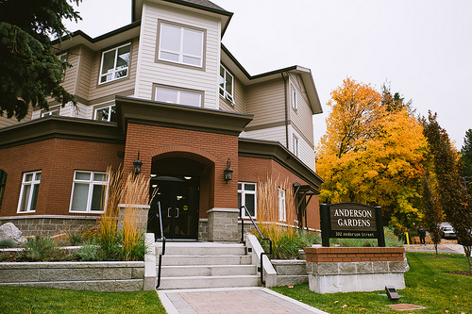
Housing Policy in b.c.
Strategy 2
Goals
B.C.’s most vulnerable citizens receive priority for assistance
Frail seniors, mental illness, physical disability, drug/alcohol addictions, women and children fleeing violence, homeless and at risk of homelessness
Manage social housing stock to ensure its stability and maximum potential
Notes:
Strategy 2 = B.C.’s most vulnerable citizens receive priority for assistance
Innovative strategy = prior to 2006 initial strategy this not the case
GOAL: MANAGE OUR SOCIAL HOUSING S TOCK TO
ENSURE I TS SUSTAINABILITY AND MAXIMUM POTENTIAL
» Maintain, upgrade and redevelop our existing social housing stock.
» Transfer stock to the non-profit housing sector where appropriate.
» Increase affordable housing options, including
new social housing where needed.
» Increase the capacity of the non-profit housing sector.
» Work with our provincial and territorial partners to
advocate for long-term federal funding.
» Consider alternative approaches to building,
maintaining and funding social housing which are adaptive to changing demands into the future
PROGRAMS
Can be same as for first strategy
Social/subsidized housing in non-profit housing
Supportive housing – usually mental illness and/or addictions
Safe houses – when fleeing violence
Transitional housing
Housing First approach = new approach = talk later on this

Slide 26
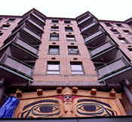
Housing Policy in b.c.
Strategy 3
Goals
Aboriginal housing need is addressed through a strong Aboriginal housing sector
Off-reserve housing
Aboriginals overrepresented in homelessness, core housing need
A strong, self-reliant Aboriginal housing sector
Through: Devolution of responsibility
Notes:
Strategy 3 = Aboriginal housing need is addressed through a strong Aboriginal housing sector
GOAL: A STRONG, SELF-RELIANT ABORIGINAL
HOUSING SEC TOR
» Work with Aboriginal housing sector to enhance Aboriginal
housing and support self-reliance of the sector.
» Support Aboriginal housing sector in promoting innovative, culturally
appropriate and sustainable social and market housing options.
» Create strategic partnerships to take advantage of innovative
opportunities and initiatives for the Aboriginal housing sector.

Slide 27
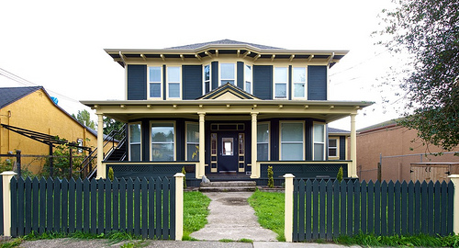
Housing Policy in b.c.
Strategy 4
Goals
Low- to moderate-income households have improved access to affordable and stable rental housing
Increased supply, choice and improved accessibility of rental housing for low/moderate income households and vulnerable populations
Streamlined systems for landlords and tenants
Notes:
Strategy 4 = Low- to moderate-income households have improved access to affordable and stable rental housing
GOAL: INCREASED SUPPLY, CHOICE AND IMPROVED
ACCESSIBILITY OF RENTAL HOUSING FOR LOW TO
MODERATE I N COME HOUSEHOLDS AND VULNERABLE
POPULATIONS
» Expand successful financing programs for
new affordable rental housing.
» Enhance rental assistance programs.
» Partner with non-profit housing sector, local governments
and developers to increase housing options and ensure
adequate supply of rental housing through innovation.
GOAL: STREAMLINED AND MODERNIZED S YSTEMS
WHICH ADDRESS LANDLORD AND TENANT
EXPECTATIONS FOR TIMELY AND EFFICIENT ACCESS TO
SERVICES AND SUPPORT CONSUMER CONFIDENCE
» Transformation of Residential Tenancy Branch services to
enhance services and meet growing and evolving demand.
PROGRAMS
Social/subsidized housing in non-profit housing
Supportive housing – usually mental illness and/or addictions
Assisted living for seniors and those with disabilities
SAFER = Shelter Aid for Elderly Renters = 60+ = subsidy in private market rental
RAP = Rental Assistance Program = working families with children = subsidy in private market rental

Slide 28

Housing Policy in b.c.
Strategy 5
Goals
Homeownership continues to be a sound option for British Columbians
Effective systems that support consumer confidence
Improved home inspector licensing
Notes:
Strategy 5 = Homeownership continues to be a sound option for British Columbians
GOAL: EFFEC TIVE SYSTEMS THAT SUPPORT
CONSUMER CONFIDENCE
» Develop an accessible, cost effective dispute resolution system for strata property owners.
» Targeted updates to the Strata Property Act, including removing barriers to critical strata repairs and enabling
the redevelopment of aging strata corporations.
» Develop model for third party dispute resolution of home warranty claims.
GOAL: HOMEOWNERS ARE PROTECTED THROUGH CLEAR
LICENSING REQUIREMENTS AND QUALIFICATIONS
» Strengthen home inspector licensing.
Strata Properties
About one quarter of all BC residents now live in strata properties. This number is growing for many reasons, including a trend toward smaller
household sizes; an aging population; emphasis on more compact, transit friendly neighbourhoods; the increase in strata units as investment/rental
suites; and the greater affordability of some strata housing relative to other housing types. Strata properties are a popular choice for the convenience,
security, added amenities and value. With nearly one million British Columbian’s now living in strata units, it is important they be well
managed, maintained and sustainable over the longer term with better options available when disputes arise.
THE PROVINCE PROVIDES A WIDE RANGE OF
PROGRAMS TO SUPPORT HOMEOWNERSHIP:
• The Home Owner Grant offers reductions in residential property taxes for the primary residence of homeowners when the value of the
residence is within a designated limit.
• The First Time Home Buyers’ Program is designed to help British Columbians purchase their first home by providing an
exemption from Property Transfer Tax for homes valued below a certain threshold.
• The Province offers property tax deferment programs for property owners 55 years and older, a surviving spouse or person with
disability, and those who support a dependent child.
• In 2009, the Province passed a number of amendments for better consumer protection and clarity in the Strata Property Amendment
Act, including requiring better information disclosure for purchasers and allowing developers to permanently designate strata lots
as eligible to be rented, regardless of ownership and any rental restriction bylaws subsequently passed by a strata corporation.
• Through the Homeowner Protection Office:
° homes built by Licensed Residential Builders must have 2-5-10 year home warranty insurance — the strongest construction defect
insurance in Canada; and
° licensing fees have funded building science research that aims to improve the quality of residential construction and educate
builders and consumers.
Note:
When so many people struggle to find quality, affordable housing, some people think should not ‘subsidize’ home owners such as through property taxes (home owner grant)
Debate whether keeping elderly in single detached homes by providing property tax deferral is good use of housing (young people can’t afford housing but we subsidize elderly to stay ‘over housed’ because they are ‘not responsible’ for the increased ‘value’ of their homes = policy tension)

Slide 29
Housing Policy in b.c.
Strategy 6
Goals
B.C.’s governance framework for housing, building and technical equipment safety is clear, effective and balanced
Safety risks are identified and managed properly
Safety, economic and social interests are recognized, balanced and managed appropriately
Notes:
Strategy 6
B.C.’s governance framework for housing, building and technical equipment safety is clear, effective and balanced
GOAL: SAFETY R I S K S ARE IDENTIFIED AND
MANAGED APPROPRIATELY
» Establish a Uniform Building Code.
» Provide provincial guidance and expert evaluation
of innovative building solutions.
» Review of the Safety Standards Act to ensure that it
continues to provide the tools to effectively regulate
new products, technologies and industries.
» Facilitate partnerships with, and provide education to, local
governments and community agencies to encourage infill,
redevelopment and higher density development.
GOAL: SAFETY, E CONOMIC AND SOCIAL INTERESTS ARE
RECOGNIZED AND BALANCED
» Establish knowledge, skills and competency requirements
for key participants in the system including licensed
residential builders and building officials.
» Establish certification program for elevating device
mechanics under the Safety Standards Act.

Slide 30
Housing First Strategy
Housing First Strategy
At Home/Chez Soi Study
Shift in provision of housing to needy populations
Formerly: stabilize life, then eligible for housing
Housing First: No barriers to housing, provide supports
Housing First effective strategy
$10 investment in housing services average savings of $9.60 for high needs participants and $3.42 for moderate needs
Notes:
Housing First Strategy
‘new approach’ in Canada
Close presentation on a positive note = something that is ‘new’ to Canada and proving successful in helping to house the homeless and hard to house
http://www.mentalhealthcommission.ca/English/issues/housing?routetoken=b20c553170dacd45d54dd312b7ba7e55&terminitial=23
What Is The Issue?
Despite our social security system, homelessness is a serious problem in Canada. An estimated 150,000 to 300,000 people are homeless across the country, costing Canadians $1.4 billion each year in health care, justice and social services costs. While many factors can lead to homelessness, mental health plays a significant role—an estimated 25 to 50 per cent of homeless people live with a mental health disorder. Solving this social crisis will require new ways of helping these critically vulnerable Canadians.
We know that the social determinants of health often make the difference between being able to live healthy, productive lives and being chronically ill and disadvantaged. Decent affordable housing is one of the essential building blocks for health and wellbeing. Without it, we all are more likely to become or stay ill and our efforts to take care of ourselves and our families can be seriously hampered.
Recovery begins with a place to call home
For people living with mental illness who are homeless, recovery can’t happen without adequate housing. Not only do people experiencing homelessness face significant physical health risks—homelessness can reduce a person's life expectancy by 20 years—existing mental health problems can also be exacerbated. Without a home to provide an element of stability and control—a safe place to call their own—facing the daily challenges of life is nearly impossible.
Shifting the mental health and housing paradigm
The provision of housing has traditionally come after a person has achieved a certain level of recovery. That is, housing was not provided until the person could demonstrate certain life skills often tied to treatment, such as sobriety. Moreover, the housing provided to individuals meeting these conditions is not the kind most people would choose as it is often of low quality and concentrated in a small number of neighbourhoods.
A Housing First approach represents a shift in the traditional paradigm—and is showing significant promise in helping people who are homeless and living with mental health issues. Programs using this approach provide housing to the people who need it most, and then provide them with the treatments and supports of their choosing. The Housing First orientation to recovery is beginning to be applied in some jurisdictions and has yielded positive results thus far—but more such programs are needed.
Mental Health Commission of Canada
At Home/Chez Soi Study – final results just released
Released in April 2014, the National At Home/Chez Soi Final Report demonstrates that Housing First works to rapidly end homelessness for people experiencing mental illness, and can be effectively implemented in cities of different size and different cultural contexts. It also proves that Housing First is a sound investment, with every $10 invested in Housing First services resulting in an average savings of $9.60 for participants with high needs and $3.42 for participants with moderate needs.
SAVINGS = reduced costs for policing, emergency services and other first responders, health services (much provided ‘free’ to residents), criminal justice system etc.
SAMI – Severe Addictions and Mental Illness
very challenging population to work with
New drugs = permanent changes to brain – likely never recover and will always need supports
Shift also in last 20 years to treatment of mentally ill in the community rather than large institutions = but community support is not always sufficient for SAMI

Slide 31
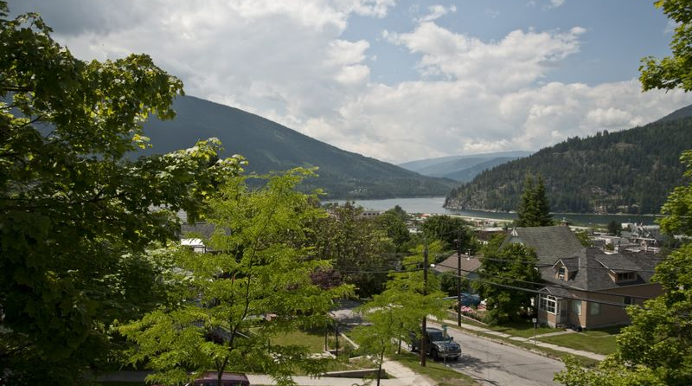
Dale.Anderson@gov.bc.ca
THANK YOU AND QUESTIONS
Notes:
Questions/discussion
Add other items once speak w Aysegyl
Ideas to add – April 22
Links to other provincial housing policies e.g., NS, ON, MB

Slide 32
Provincial players
Example
BC Housing
HPO
Real Estate Sector
Builders
Business
New home warranty program
Notes:
The provincial government has itself or regulates several plays in the housing world in BC;
Providing stewardship of the building code, creating efficiencies that make it easier for communities to approve options such as secondary suites. [http://www.bccodes.ca]
Developing uniform technical standards that simplify Building Code compliance.
Ensuring effective regulation of real estate development and marketing, home warranty insurance, [http://www.hpo.bc.ca/] and landlord-tenant relations [http://www.rto.gov.bc.ca/] to protect buyers and renters [http://www2.gov.bc.ca/gov/theme.page?id=043ED83FA4319EF9EC01F4F5C5FD94FD].
Ensuring the effective regulation of land use planning and development finance.
Investing in public transit.
Funding social housing programs and projects in communities across the province, through BC Housing, [www.bchousing.org] and in partnership with local governments, non-profit agencies, and other housing stakeholders.
Providing targeted rent supplements to keep the cost of private market rentals affordable for low-income working families and seniors.
Providing financial assistance, such as the Home Owner Grants [http://www.sbr.gov.bc.ca/individuals/Property_Taxes/Home_Owner_Grant/hog.htm] to help pay property taxes, Property Tax Deferment Programs, [http://www.sbr.gov.bc.ca/individuals/Property_Taxes/Property_Tax_Deferment/ptd.htm] tax exemptions through the First Time Home Buyers’ Program, [http://www.sbr.gov.bc.ca/documents_library/brochures/FirstTimeHomeBuyer.pdf] Home Adaptations for Independence [http://www.bchousing.org/Initiatives/Renovating/HAFI] and the Seniors’ Home Renovation Tax Credit. [http://www.sbr.gov.bc.ca/individuals/Income_Taxes/Personal_Income_Tax/tax_credits/seniors_home_reno.htm]
Local Government Role
Much of this website outlines actions local governments can take to enhance housing affordability in their communities. Some of these actions include:
Adopting Regional Growth Strategies and community and neighbourhood plans that encourage affordable housing units.
Nurturing a housing friendly regulatory environment by allowing secondary suites and promoting increased density and housing options.
Establishing pre-zoned land for development and higher density transit corridors.
Providing property tax incentives to build new affordable housing and renovate existing affordable housing.
Streamlining development approval processes.
Providing targeted reductions for development cost charges and permitting fees.
Learn more about these and other options on the Policy and Implementation sections of this site.
Federal Role
The federal government also plays a key role in housing. Some of the federal activities include:
Partnering with the province to provide investments in social housing.
Providing seed funding and proposal development funding at the early stages of an affordable housing project through the Canada Mortgage and Housing Corporation.
Providing financial assistance through tax credits and exemptions, such as the
First Time Home Buyer’s Tax Credit, [http://www.cra-arc.gc.ca/gncy/bdgt/2009/fqhbtc-eng.html]
Home Buyers’ Plan [http://www.cra-arc.gc.ca/tx/ndvdls/tpcs/rrsp-reer/hbp-rap/]
and exemption from capital gains tax for principal residences. [http://www.cra-arc.gc.ca/tx/ndvdls/tpcs/ncm-tx/rtrn/cmpltng/rprtng-ncm/lns101-170/127/rsdnc/menu-eng.html]
Providing mortgage insurance to assist homeowners who buy homes with lower down payments. [http://cmhc.ca/en/co/moloin/index.cfm]
Undertaking research on the housing market and related topics, through the Canada Mortgage and Housing Corporation. [http://www.cmhc-schl.ca/en/index.cfm]

